Slide 1


Slide 2

Deciphering the Influence of Ad Rank on Customer Engagement in Search Engine Marketing using SAS®
West Coast Wizards
Shimeng (Summer) Wang Mrigangka Medhi Peilin (Penny) Zhao

Slide 3




Team Members
Prof. Francisco Castro
Shimeng (Summer) Wang
Mrigangka Medhi
Peilin (Penny) Zhao

Slide 4




Outline
Introduction
Data Preparation
Data Analysis
Conclusion

Slide 5


Study Overview
Examine the impact of ad rank on keyword auction performance within search engine marketing (SEM) using Yahoo data
Provide insights for business aiming to optimize their search engine advertising strategies
Introduction
Data Preparation
Data Analysis
Conclusion

Slide 6
SEM in Digital Marketing
Significance of Search Engine Marketing (SEM)
Increase website’s visibility
Primarily through paid advertising
Role of Keyword Auctions
Advertisers bid on keywords
Allow ads to show up along with the search results
Introduction
Data Preparation
Data Analysis
Conclusion

Slide 7
Yahoo Auction-Based Advertising Model
Choose Keywords
Trigger Auction with Search
Ads Compete in Auction
Rank and Display Ads
Pay for Clicks
Introduction
Data Preparation
Data Analysis
Conclusion

Slide 8
Problem Statement
Limited understanding of ad rank’s direct impact on customer engagement
Need empirical evidence to guide advertisers on the efficacy of improving ad positions
Finding the right balance between ad spending and performance is not easy
How to optimize ad visibility and user engagement
Introduction
Data Preparation
Data Analysis
Conclusion

Slide 9
Transforming Business Issue to Analytical Challenges
Click
Track each customer-initiated click and total clicks
Impression
Count of ad appearances on search engine results page
Click-Through Rate (CTR)
The ratio of click to impression
Introduction
Data Preparation
Data Analysis
Conclusion

Slide 10
Research Questions
How does ad rank influence the volume of clicks and impressions?
What is the relationship between ad rank and click-through rate?
Can higher ad positions significantly improve campaign outcomes?
1
2
3
Introduction
Data Preparation
Data Analysis
Conclusion

Slide 11
Methodology Overview
Acquire Data from Yahoo
Perform Data Cleaning & Exploratory Analysis
Apply Regression Model
Introduction
Data Preparation
Data Analysis
Conclusion

Slide 12
Yahoo Auction Data Was Considered
Publicly available keyword auction data from Yahoo
Daily bidding activities of companies
Rank of search engine ads & corresponding impressions / clicks
Collected over 4-month period in 2008
Introduction
Data Preparation
Data Analysis
Conclusion

Slide 13
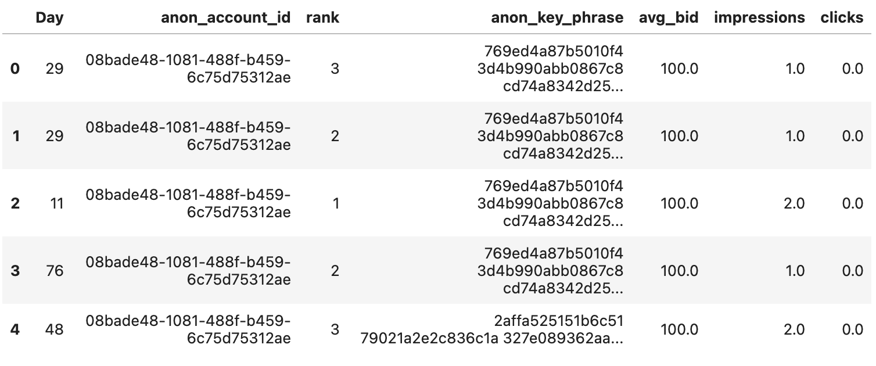
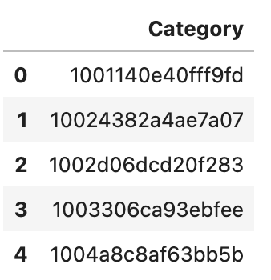
Data Consisted of Bidding Information On Keyphrases
Keyphrase bidding data (77.8M rows)
Keyphrase category data (75.3K rows)
Introduction
Data Preparation
Data Analysis
Conclusion

Slide 14
Data Was Consistent With Standard Quality Checks
Checked for missing values
Consistent domain check
Referential integrity
None
Correct data types in each column
Checked that each keyphrase was made up of only keywords from second file, no other words present
Introduction
Data Preparation
Data Analysis
Conclusion

Slide 15
Daily Avg Impressions And Clicks Exhibited Similar Trends
75.3K
3.28
11.23
# of Unique Keywords
Avg. # of Keywords in a Keyphrase
Avg. # Daily Impressions per Keyphrase
16.3K
4.85
0.18
# of Unique Accounts
Avg. # of Accounts Bidding for Same Keyphrase
Avg. # Daily Clicks per Keyphrase
Introduction
Data Preparation
Data Analysis
Conclusion

Slide 16
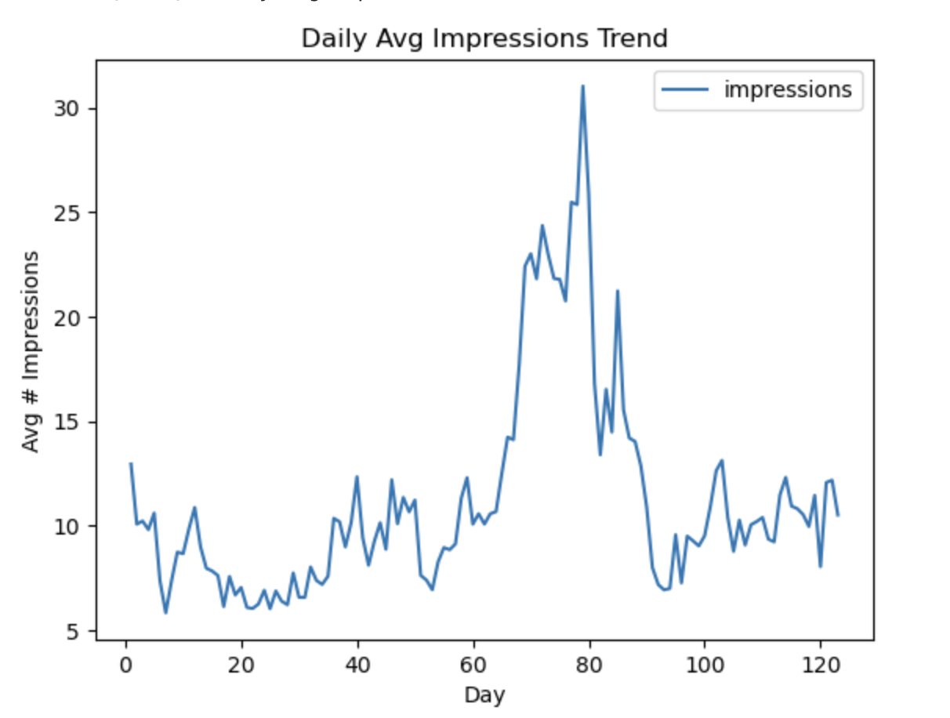
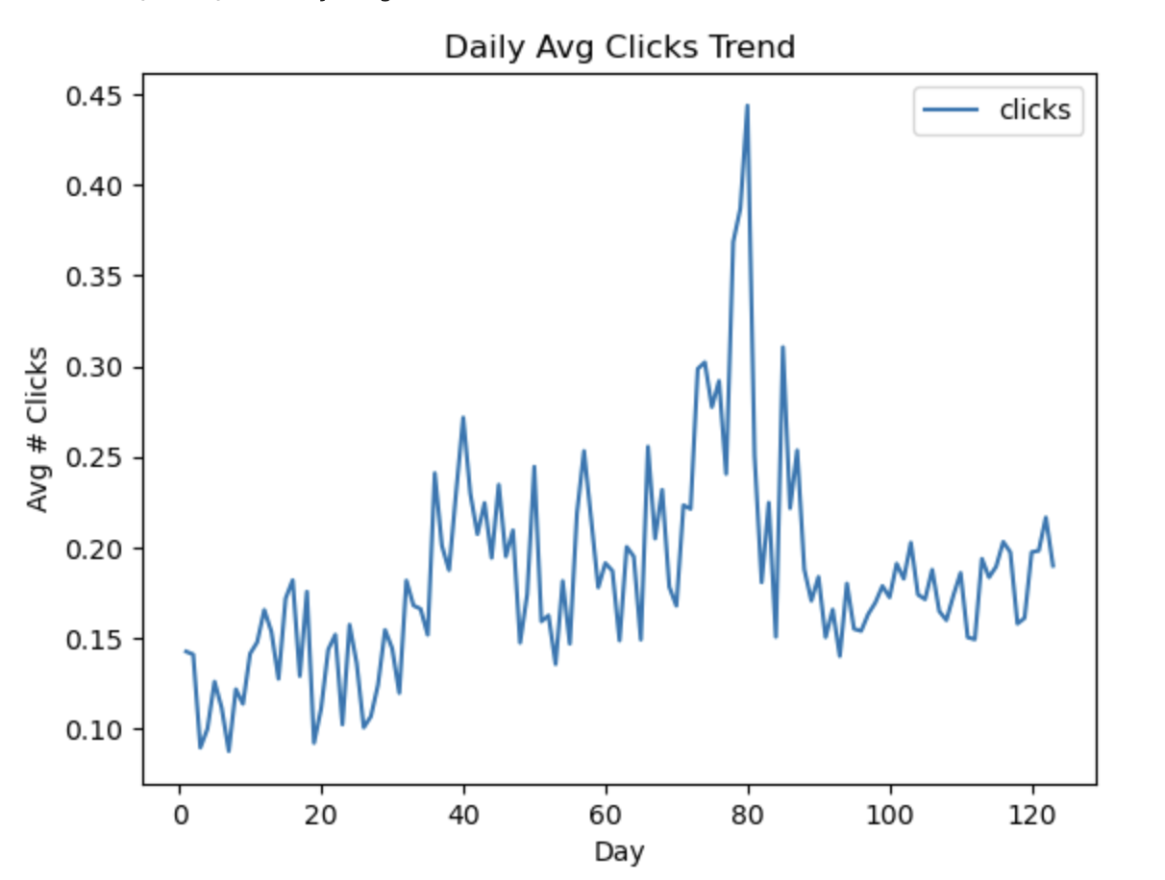
Daily Avg Impressions And Clicks Exhibited Similar Trends
Daily trends of avg clicks/impressions per keyphrase
Introduction
Data Preparation
Data Analysis
Conclusion

Slide 17
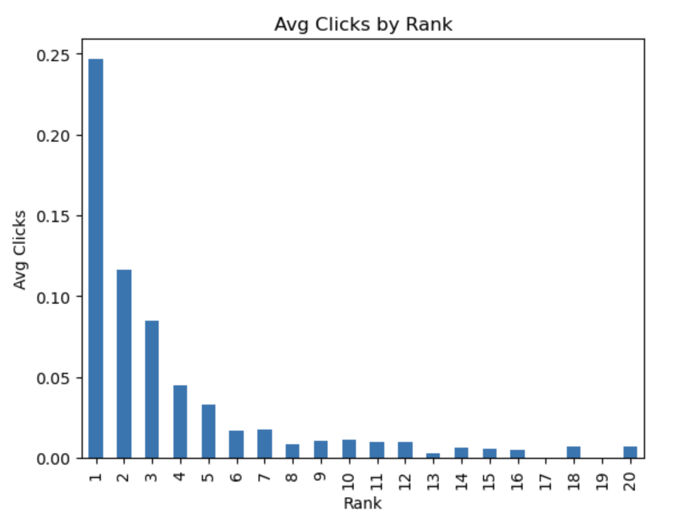
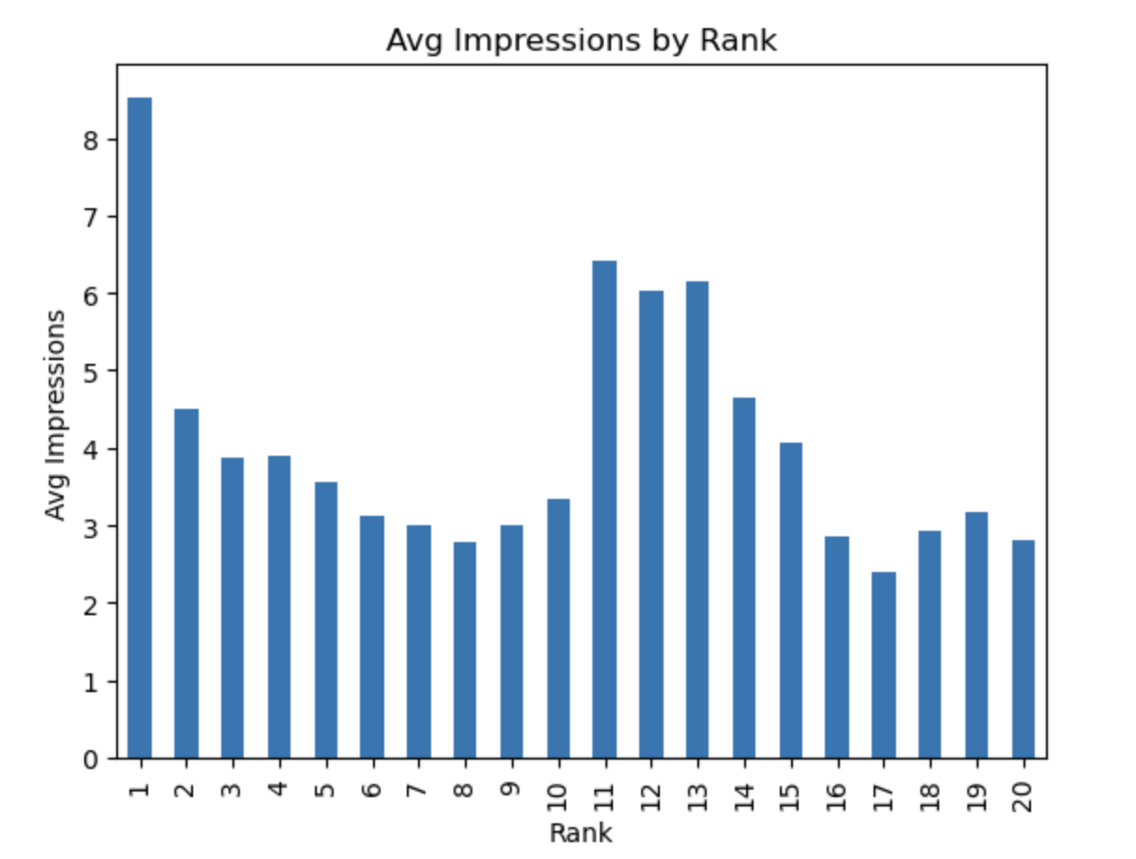
Initial Exploration Uncovered Clear Correlation Between Rank And Engagement
Clicks & impressions both have a downward trend with increasing rank
Clicks monotonically decrease, big drop from 1 to 2
Impressions spike at rank 11 because ads are positioned at the top of the second page
Introduction
Data Preparation
Data Analysis
Conclusion

Slide 18
Challenge Encountered: Large Dataset
Large data volume
Over 77 million records
Computationally intractable
Take lots of time and memory
Need to find a way to find a small but representative sample
Introduction
Data Preparation
Data Analysis
Conclusion

Slide 19
Refined Data Cleaning Strategy was considered to avoid bias
Filtering by days
There are risks of bias and incomplete representation
Initial Strategy
Random selection of 1,000 key phrases among all key phrases
No bias based on trends
Reduction to 84.7K records for a manageable and representative dataset
Refined Strategy
Introduction
Data Preparation
Data Analysis
Conclusion

Slide 20
Quality Checks Were Performed On The Smaller Dataset
1.6K
3.29
11.25
# of Unique Keywords
Avg. # of Keywords in a Keyphrase
Avg. # Daily Impressions per Keyphrase
856
4.88
0.18
# of Unique Accounts
Avg. # of Accounts Bidding for Same Keyphrase
Avg. # Daily Clicks per Keyphrase
Introduction
Data Preparation
Data Analysis
Conclusion

Slide 21
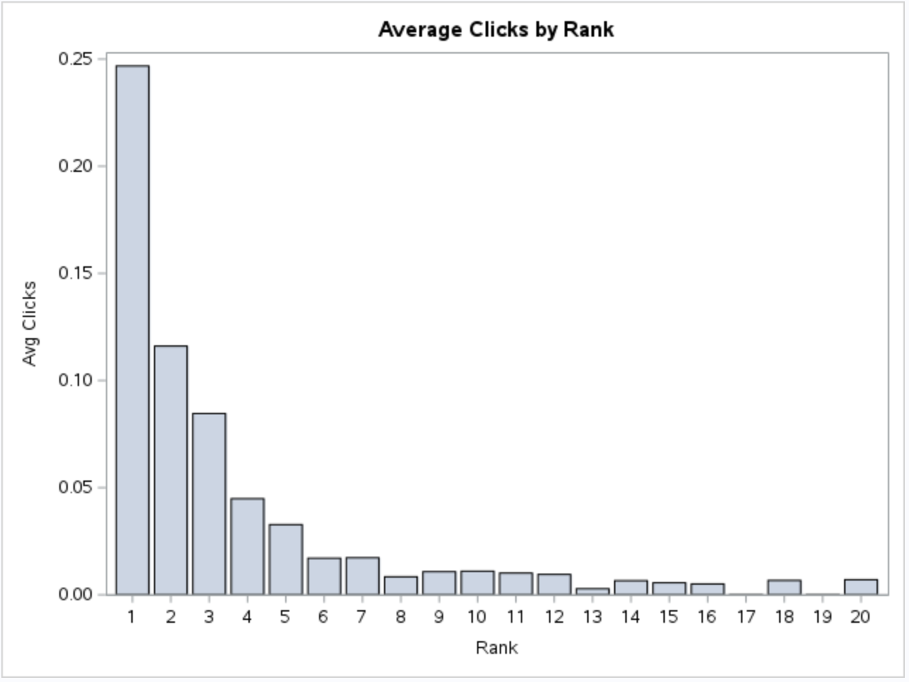
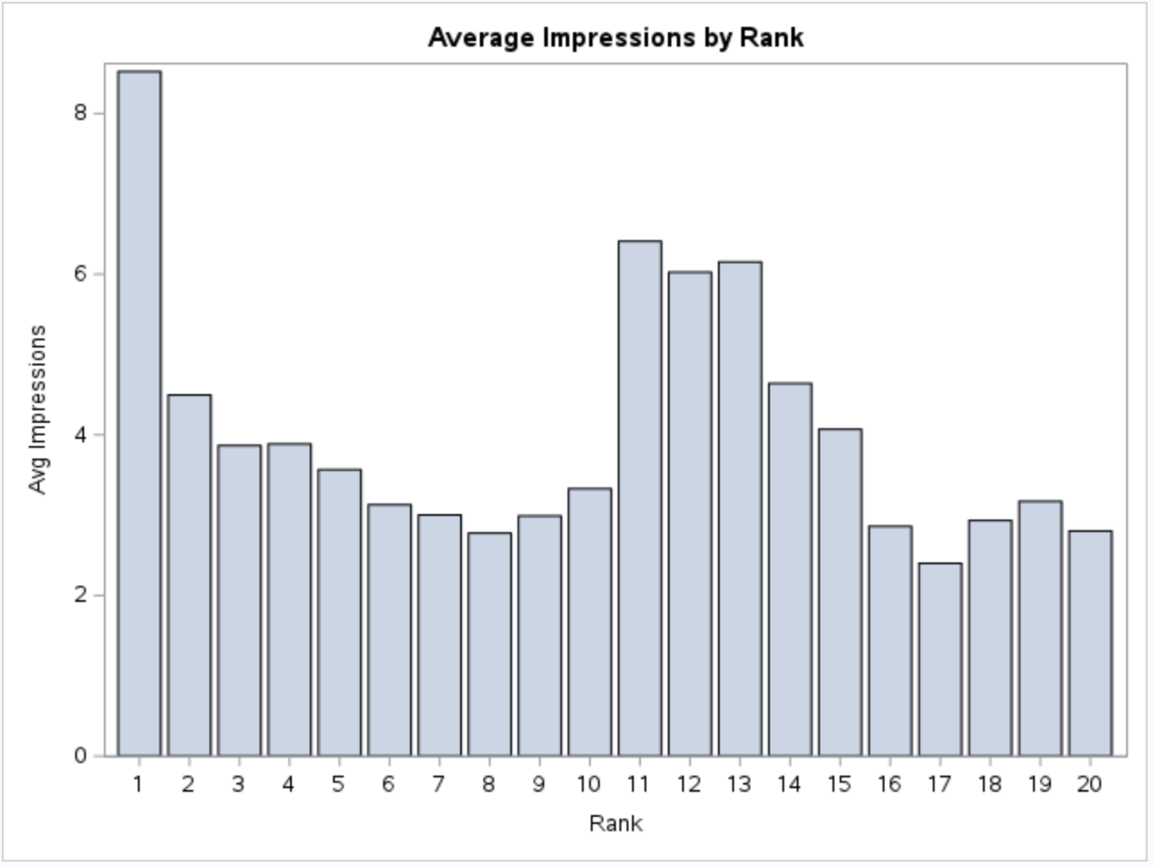
Quality Checks Were Performed On The Smaller Dataset
Introduction
Data Preparation
Data Analysis
Conclusion

Slide 22
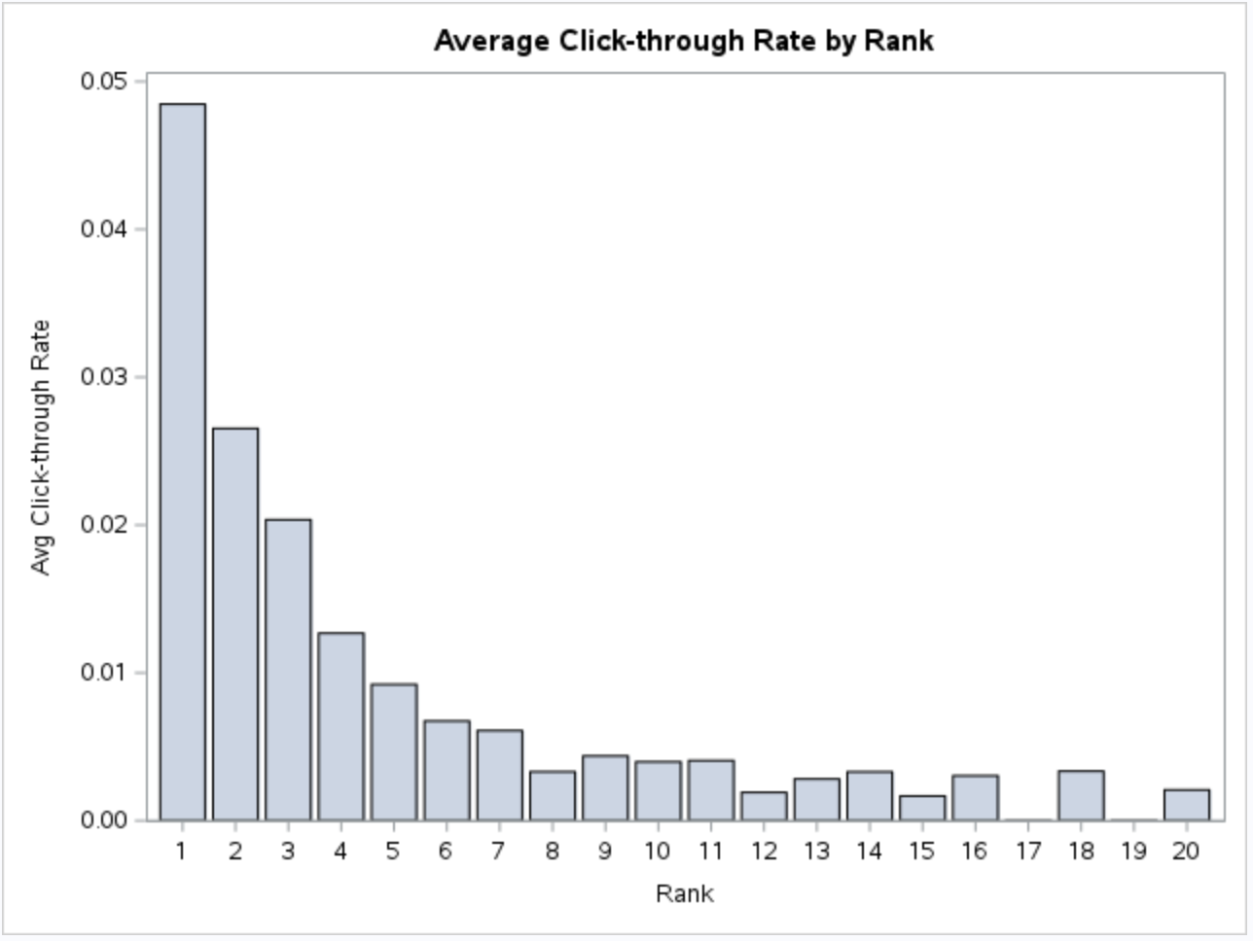
CTR Was Determined To Measure Ad-Potency
Click-through rate (CTR)
Measure the conversion rate of impressions made
Handling anomalies (CTR > 1)
CTR monotonically decrease, big drop from 1 to 2
Introduction
Data Preparation
Data Analysis
Conclusion

Slide 23
Additional Predictor Variables Were Introduced
Keyword extraction and dummy variable generation
Dummy binary variable for each keyword
Calculation of competitors per keyphrase
Calculate at an overall level, not daily
Competitors can bid on the keyphrase on different days
Introduction
Data Preparation
Data Analysis
Conclusion

Slide 24
Use Linear Regression For Causal Inference
Impact of ad rank on customer engagement metrics
Clicks
Impression
Click through rate
The coefficient reflects how improving in 1 unit in rank affects engagement metrics
Look at a particular jump in rank
rank 1 -> rank 2
rank 3 -> rank 4
Introduction
Data Preparation
Data Analysis
Conclusion

Slide 25
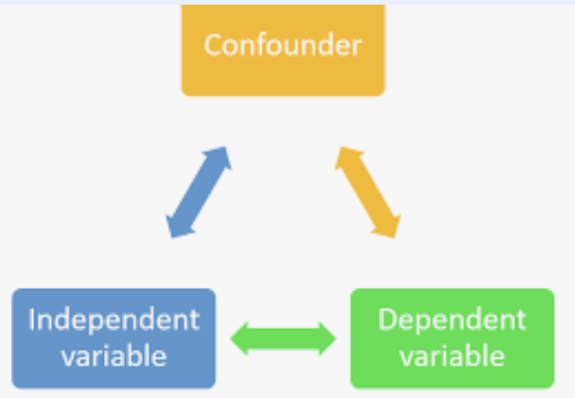
Simple Approach may cause OVB
Regression Model:
- Clicks_per_ad = β0 + β1 * Ad_ranks + ε
- Impression_per_ad = β0 + β1 * Ad_ranks + ε
- CTR_per_ad = β0 + β1 * Ad_ranks + ε
Problem → introduce OVB
Introduction
Data Preparation
Data Analysis
Conclusion

Slide 26
Introduce control variables to prevent OVB
Regression Model
- Clicks_per_ad = β0 + β1 * Ad_ranks + β2 * Time + β3 * Account_ID + β4 * Keyword_1 + β5 * Keyword_2 + ... + βn * Keyword_n + ε
Time fixed effect: Day
Unit fixed effect: Account ID
Keyword dummies
Additional controlled variables
- model 2: + number of competitors
- model 3: + number of competitors & average bid amount
Introduction
Data Preparation
Data Analysis
Conclusion

Slide 27
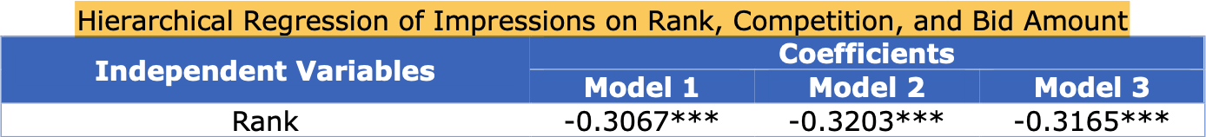
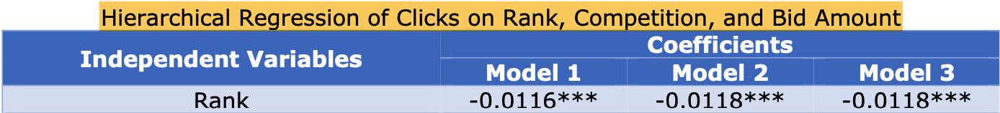
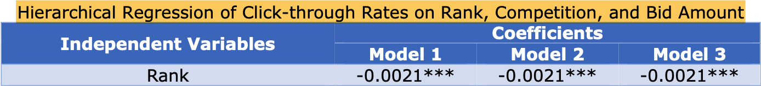
Model 3 provides the most comprehensive insights
Introduction
Data Preparation
Data Analysis
Conclusion
Notes:
The first slide of result interpretation

Slide 28
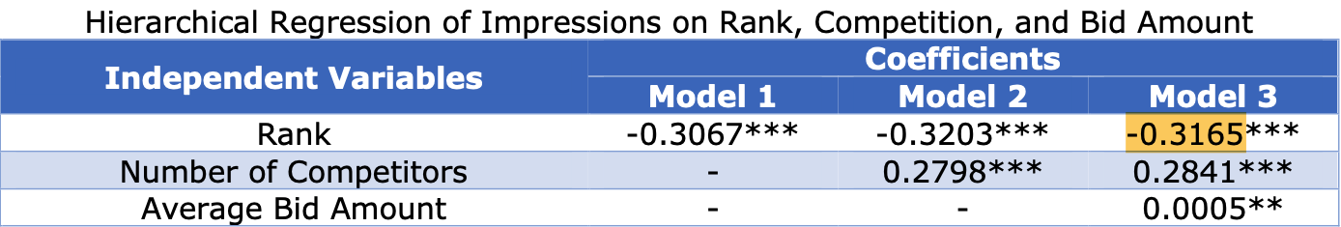
Impact of ad rank on Impressions
Ad rank increase by one -> decrease in impressions by 0.31 units
higher ad rank generally translates to greater visibility to potential customers

Slide 29
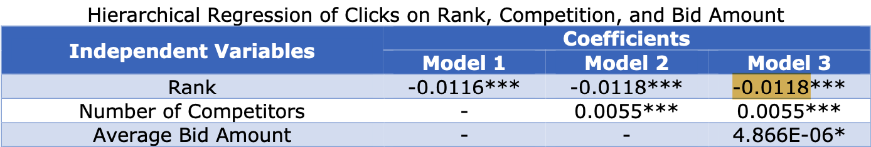
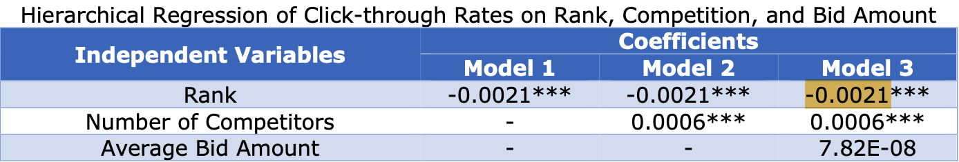
Impact of ad rank on clicks & CTR
Introduction
Data Preparation
Data Analysis
Conclusion
Notes:
The second slide of result interpretation

Slide 30
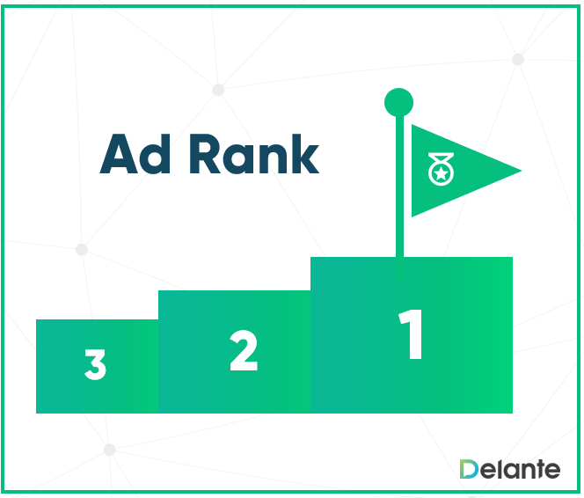
Ad rank has the most significant effect on Customer Engagement
Introduction
Data Preparation
Data Analysis
Conclusion
Notes:
The third slide of result interpretation

Slide 31
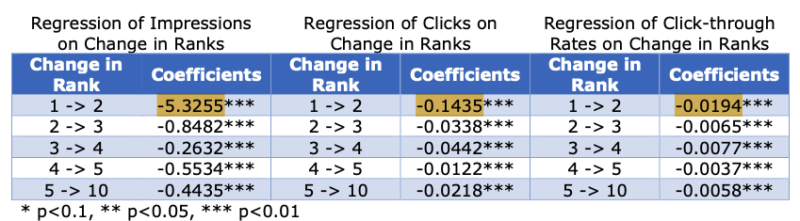
Impact of a specific rank jump
Transition from rank 1 to rank 2 results in the most significant decrease in engagement level
Importance of maintaining a top ad rank: Bid for rank 1 if possible
Introduction
Data Preparation
Data Analysis
Conclusion

Slide 32
Conclusion
Ad rank significantly impacts customer engagement, more than the number of competitors or bid amounts
Control Variables Enhance Accuracy
Business should prioritize ad rank to boost their visibility and customer engagement level
Introduction
Data Preparation
Data Analysis
Conclusion

Slide 33
Assumptions and Limitation
Key Assumptions
- Keyword Order in bids is not significantly impactful
- Simplification for feasibility, but may overlook nuanced effects
Potential Limitations
- Omitted variable bias
- Smaller data analysis
Introduction
Data Preparation
Data Analysis
Conclusion

Slide 34
Further Analysis
Analyze Timing Patterns
Assess ad performance by time to optimize bid adjustments for specific times, achieving cost-effective visibility
Utilize Demographic Data
Tailor bids based on demographic insights to target more profitable audience segments, increasing ad effectiveness
Conduct A/B Testing
Implement and analyze A/B tests for ads and bids to continuously identify and apply more profitable strategies
Introduction
Data Preparation
Data Analysis
Conclusion

Slide 35
Thank you! Contact Information
Mrigangka Medhi
mrigangka.medhi.2024@anderson.ucla.edu
Shimeng (Summer) Wang
shimeng.wang.2024@anderson.ucla.edu
Peilin (Penny) Zhao
peilin.zhao.2024@anderson.ucla.edu

